Slide 1


Lost and Found Portal
A Simple CRUD Web Application
A clean, efficient web application for managing lost and found items with a modern tech stack.
Faiz Zakirhusen Jamadar
25PMCO28
Notes:
1

Slide 2

Introduction & Technology Stack
Project Overview
Modern, Lightweight Stack
This Lost and Found Portal is a simple yet powerful web application designed to help users report lost items and claim them through a central system. It provides an intuitive interface for managing items with full CRUD functionality—Create, Read, Update, and Delete operations.
Backend: Python—clean, readable, and powerful
Framework: Flask—a micro-framework requiring minimal code
Database: SQLite—serverless, file-based, zero setup
Frontend: HTML & CSS—standard, responsive building blocks
The application solves a real problem: creating an organized, searchable repository where community members can post discoveries and reconnect lost belongings with their owners.
Notes:
2

Slide 3
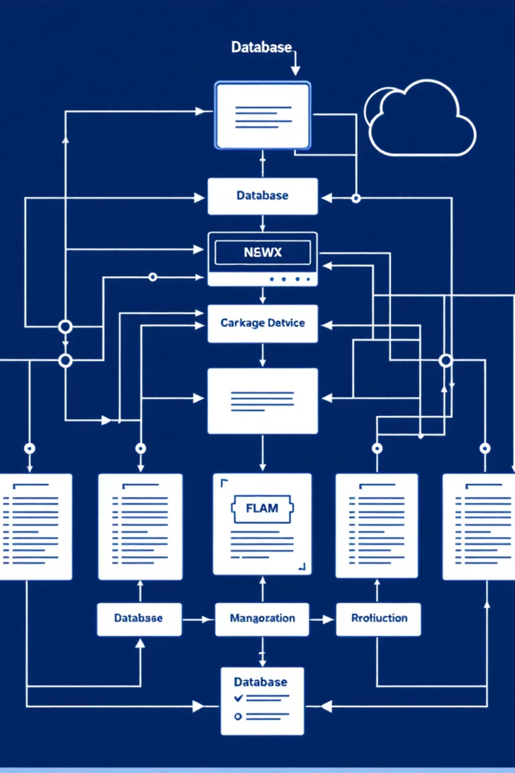

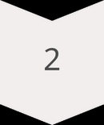

System Architecture & Data Flow
The system is structured in two levels of data flow diagrams to show both the holistic view and internal processes.
User Input
New items and management actions
System Process
Add, display, and manage items
Output
Updated item list and confirmations
Core System Processes
Add Item
Display Items
Captures user data and writes to database
Reads database to show item list
Manage Item
Updates or deletes items based on actions
Notes:
3

Slide 4
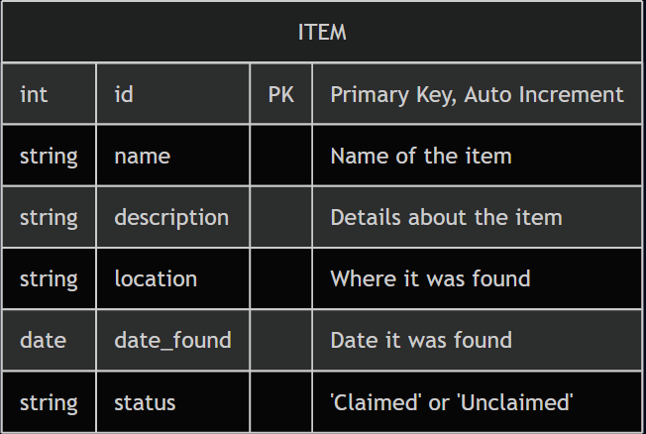
Entity-Relationship Diagram (ERD)
The ERD represents the logical structure of the database. Since this is a streamlined system, it utilizes a robust single-entity model to maintain all item records efficiently.
A streamlined single-table model optimized for efficiency and simplicity, following Third Normal Form (3NF) principles.
This 3NF structure eliminates data redundancy and ensures data integrity—all fields depend directly on the primary key with no repeating groups.

Slide 5
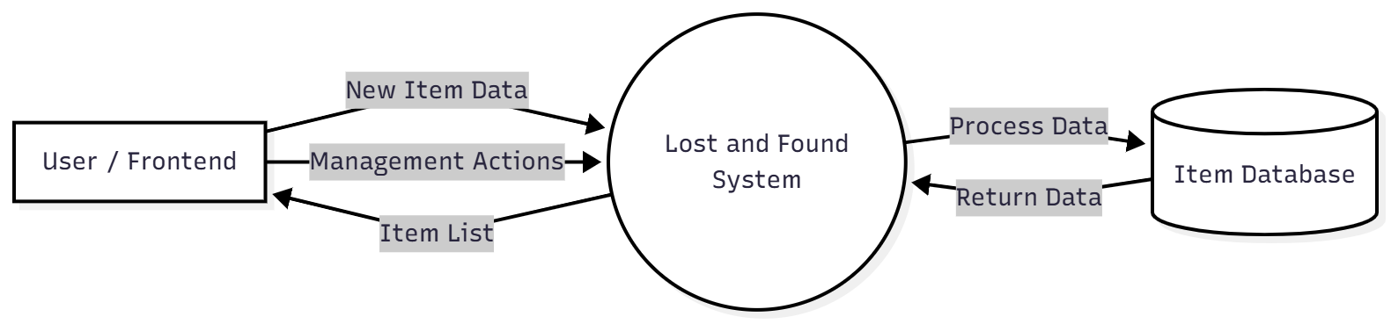
System Design (DFD Level 0)
Notes:
4

Slide 6
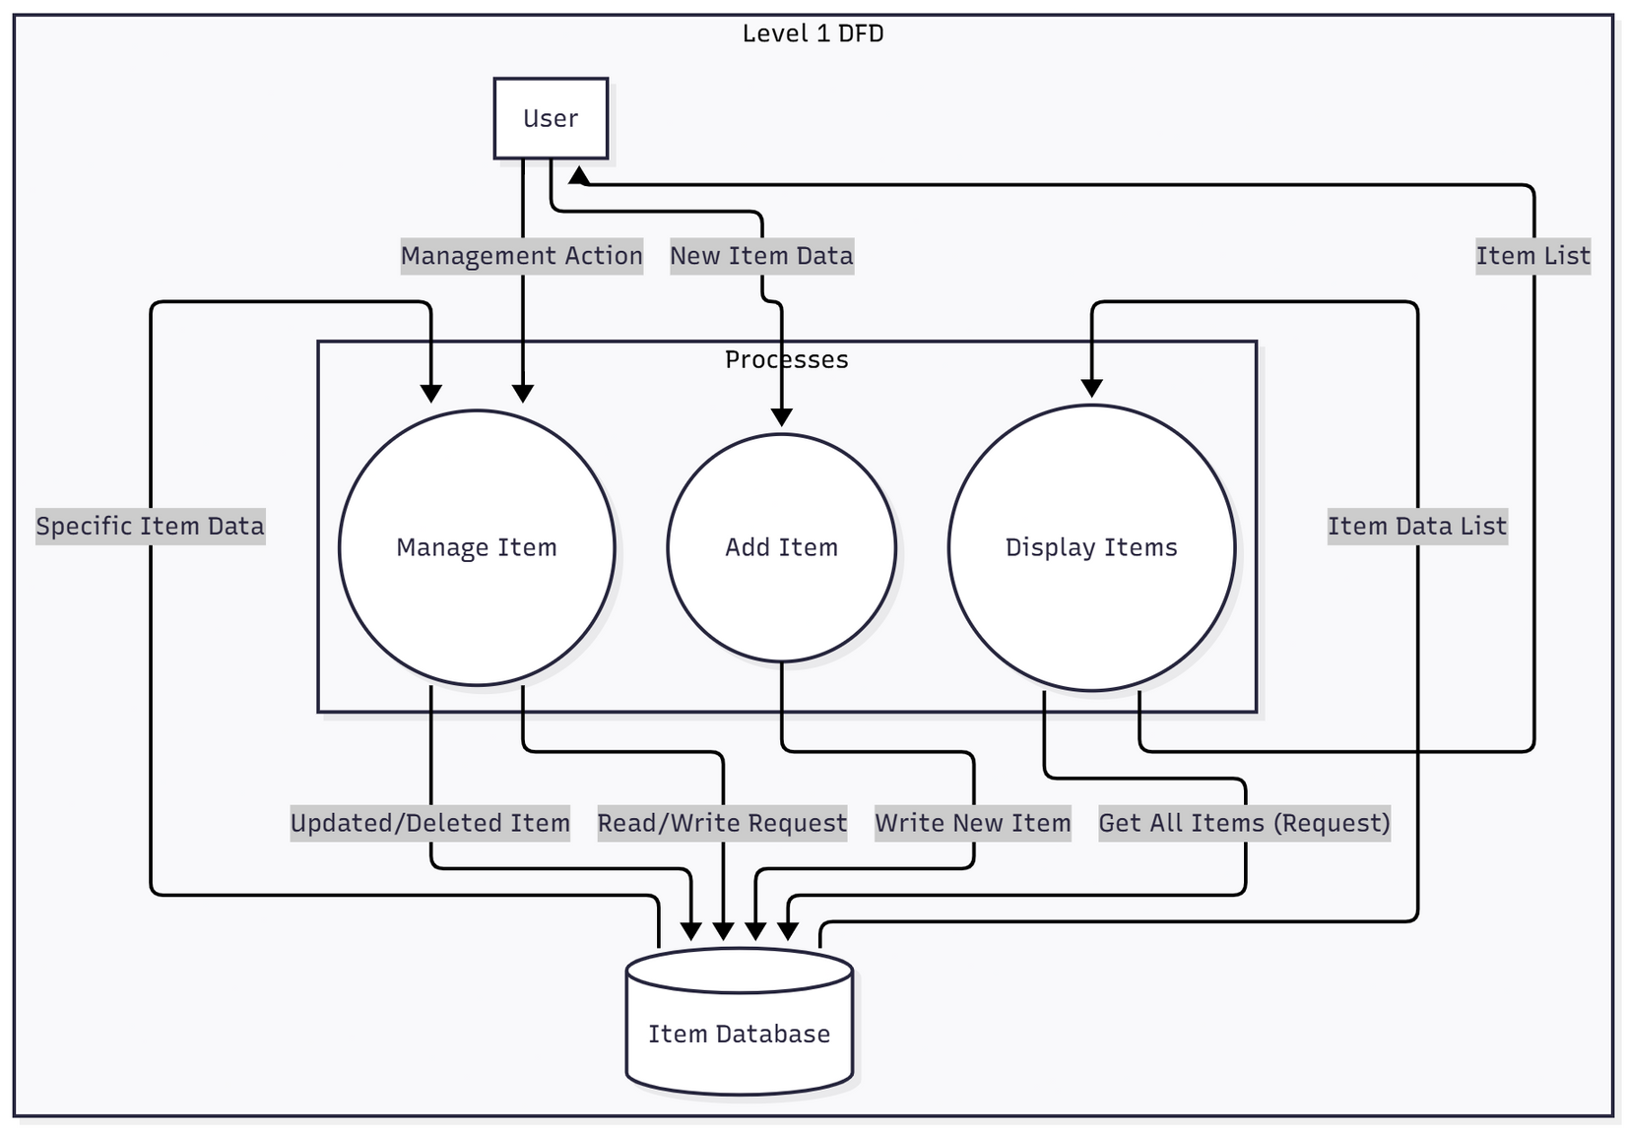
System Design (DFD Level 1)
Notes:
5

Slide 7
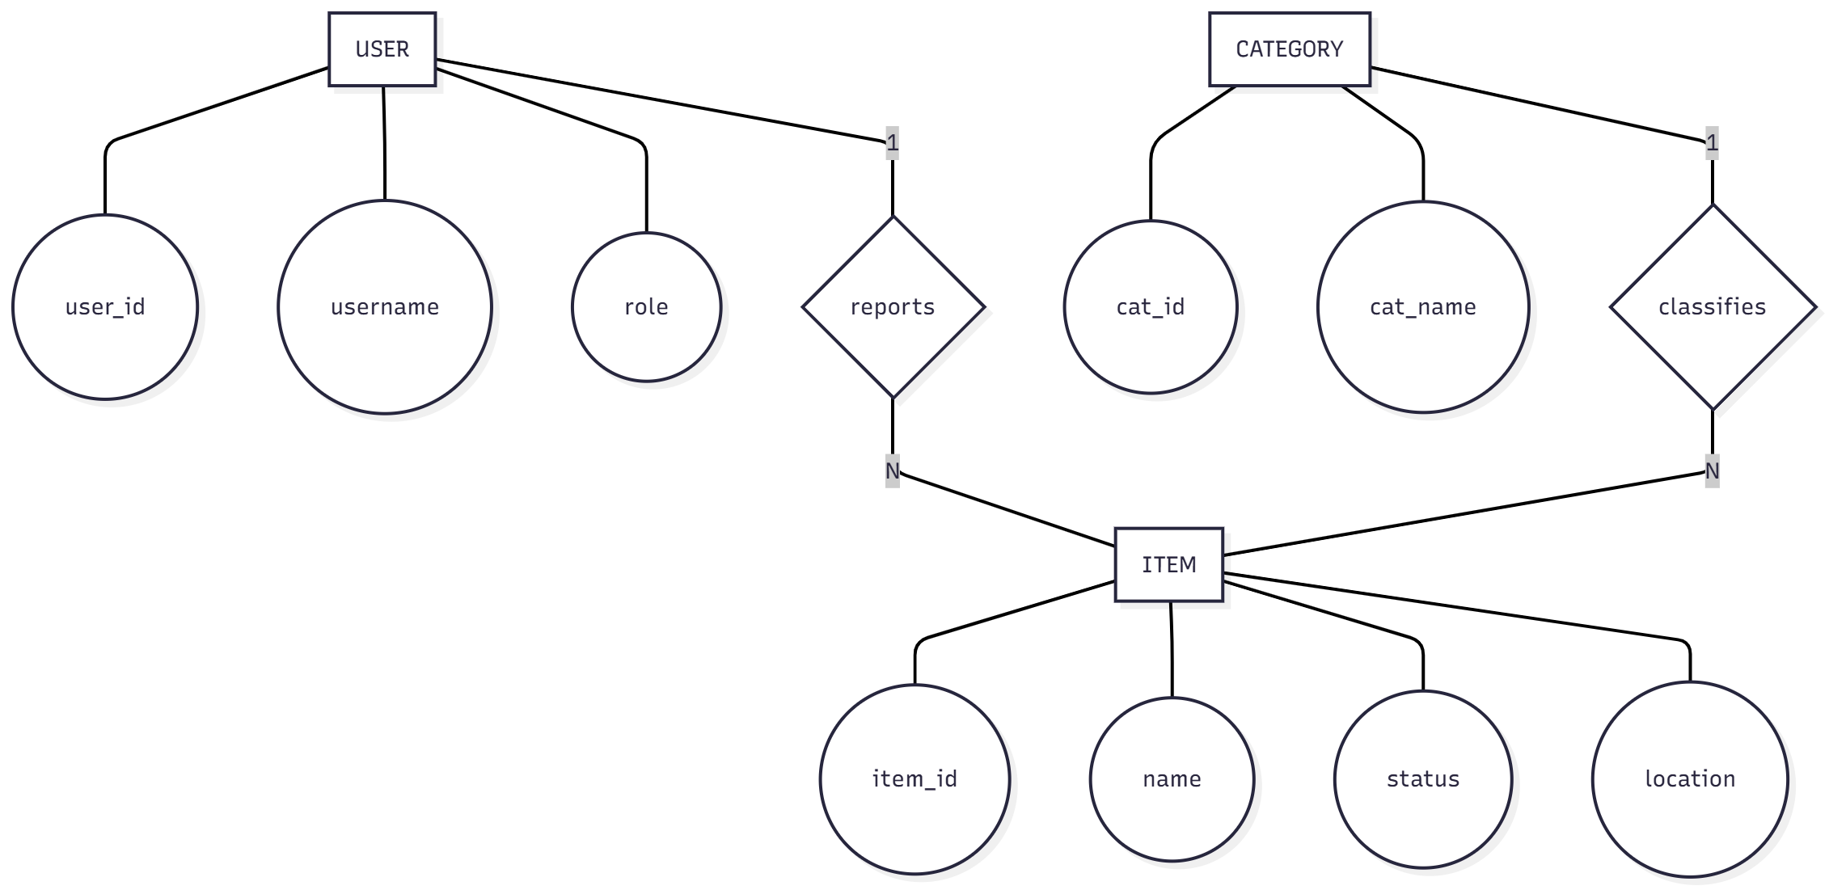
ERD

Slide 8
Thank You!
I appreciate your time and attention today. We hope this presentation provided a clear understanding of the Lost and Found Portal's design and functionality.

